Slide 1
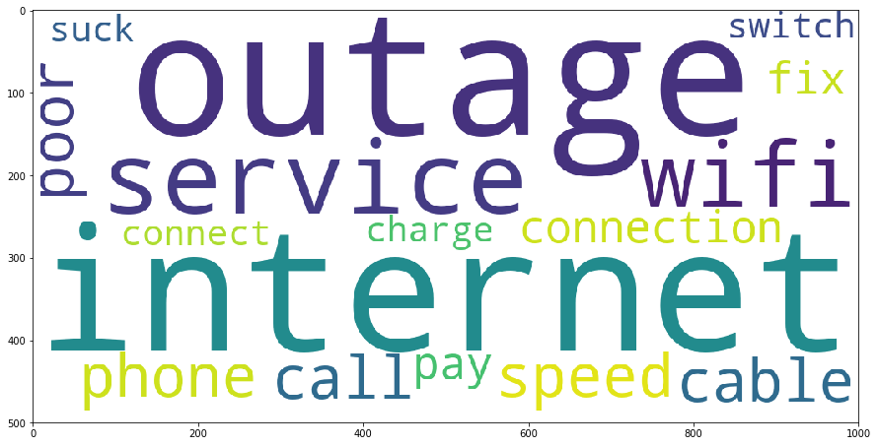
ECLERX HACKATHON
Running all data was taking time and I couldn’t get background of insights, hence I divided data wrt brands
Brand | Issue highlights /Topic Insights | Recommendations
Amazon Total: 84637 tweets, (35.72% negative) | Terrible customer service, waiting for hours | Give an option on call back Show number of minutes to wait Increase customer service executives
 | Damaged box, broken product, scratched product | Quality of product to be checked before it is packed
 | Fast delivery, ship in time | Represents positive review about delivery, though some reviews show delayed delivery & longer processing time
 | Echo: poor music | Talks about its product, Amazon echo might need to improve its volume or music content
Apple Total: 74632 tweets, (44.19% negative) | Poor battery backup, battery dies quickly when playing games | Battery seems to drain quickly, reduce power usage by screen/apps
 | Playlist hangs while streaming, screen freezes randomly | This seems to be bug or due to overuse of memory, build apps with less memory usage
Sprintcare Total: 12649 tweets, (47.75% negative) | Bad service, poor signal, switch | Improve network connection in some areas as customers want to switch Find underlying causes leading to call drop/ failed service
 | Extra charge, waste money | Some extra charges might be getting deducted by the company which customers aren’t aware of, hence they should be transparent wrt to them
ComcastTotal: Total: 23841 tweets, (41.83% negative) | Bad internet speed | Internet speed might be low in some areas, tag those areas and see if new tower can be put up
 | Call never connect | Call seems to drop, check if it is due to our connection or other network service provider
Uber Total: 40029 tweets, (47.54% negative) | Driver cancel ride/refuse | Status from driver can be taken, why is he refusing/cancelling the ride, penalize if reason not logical
 | Repay, account charge, scam, week resolve | Sometimes double payment might be taken from customers and then it is taking weeks to resolve. Payment check can be so that it is taken once
WORD CLOUD FOR COMCAST TOPICS
01
02
03
04
BUSINESS PROBLEM
UNDERSTANDING
MODELLING
SOLUTION
Given tweet data, as a Business Manager, I should be able to draw insights of major underlying issues
I want to understand prominent issues which customers are facing so that I can improve my product service accordingly
Twitter data is one of the most direct feedbacks given by the customer
If it is positive, it works well for the company’s brand however negative issues can escalate quickly and lead to customer attrition as it publicly shows company’s response to any of its customer
Since this is text data, I need to model which not only represents text in numerical/vector form but also takes into account its meaning for modelling.
To find the essence of the underlying, words that explain most of the data are captured (Topic modelling).
If an issue is important, it appears again, hence it is captured as it represents data in some way
LSI is used to uncover hidden topics while LDA is used to uncover topics building the data
Given data of 794299 tweets, we had 36.91% tweets with negative sentiment (used sentiment analyser)
Tweets are reduced to broad topics that capture most of the variance and we can look at the words in each topic to find insights about the pressing issues that customers are tweeting about.
The model is run on all negative tweets, brand-wise customer tweets to uncover customer issues and brand-wise response tweets
Brand wise insights are in table

